Slide 1

Human Hand Tracking System("H2TS=Hatuus) Development Using Python

Slide 2
Introduction
What is human computer interaction (HCI)?
It is the study of interaction between human(users) and computers.
The interaction between user(s) and computer(s) is achieved via an interface- user interface.
What is SAHVI?
SAHVI is a virtual assistance which assists user to access different tasks.
SAHVI stands for Software and human virtual interaction.

Slide 3
What are the tasks performed by this program?
Virtual Volume Controller(VVC)
Virtual Calculator(VC)
Under this feature we develop a virtual GUI for virtual calculator that uses finger movements to operate and perform some mathematical calculations.
Under this feature we develop an interface which will capture hand gesture dynamically and will control the volume level
Virtual Painter(VP)
Under this feature we develop a virtual GUI that enables one to virtually paint on the screen using their fingers.
Virtual Game Controller (VGC)
Virtual Mouse Controller(VMC)
Under this feature we develop a interface which will capture multiple hand gesture(two hands) and will control the game dynamics.
Under this feature we develop a mouse simulation system which performs all the functions performed by mouse corresponding to hand movement.

Slide 4
Objective
First objective of this project is to allow the communication between human and computer by the use of gestures and hand movements to be more intuitive.
Second objective of this project is to create a complete system to detect, recognize and interpret the hand gestures through computer vision.
Third objective of this project is to do more and more work on the computer with the help of hand gestures such as to control volume of the system, mouse control, game control and many more.

Slide 5
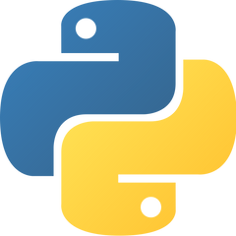



Technology Used
Python
Main Modules Used
OpenCV
MediaPipe

Slide 6
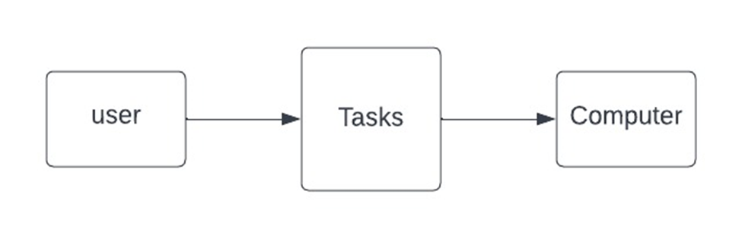
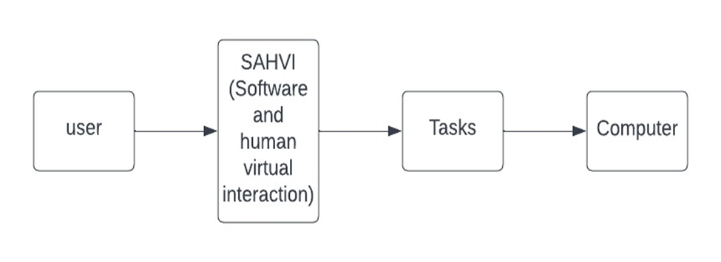
DFD Diagram
Level Zero Diagram
Level One Diagram

Slide 7
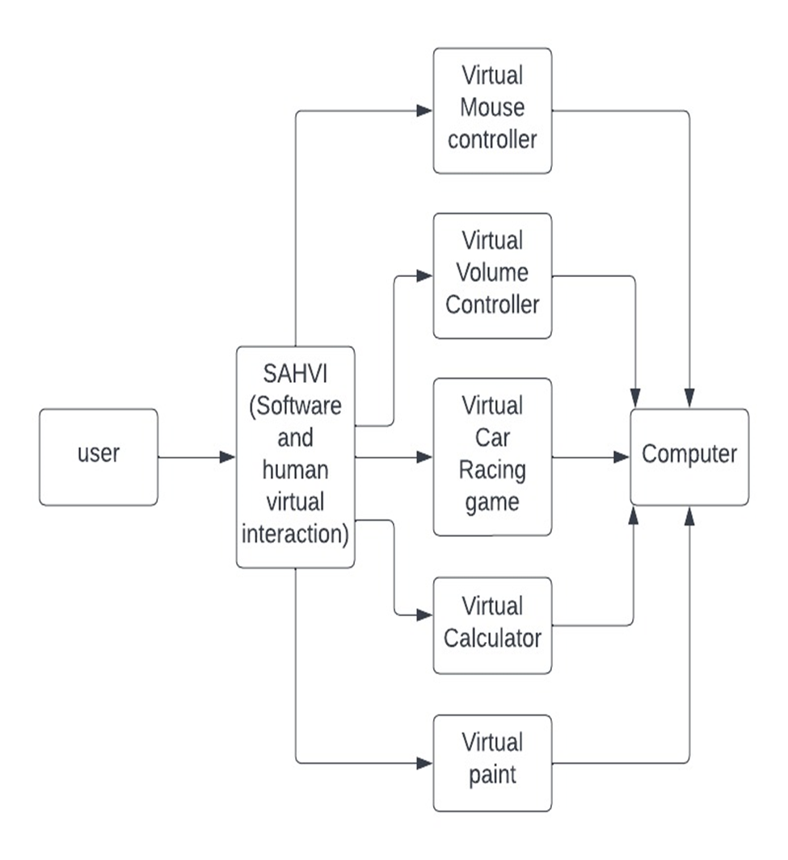
Level Two Diagram

Slide 8
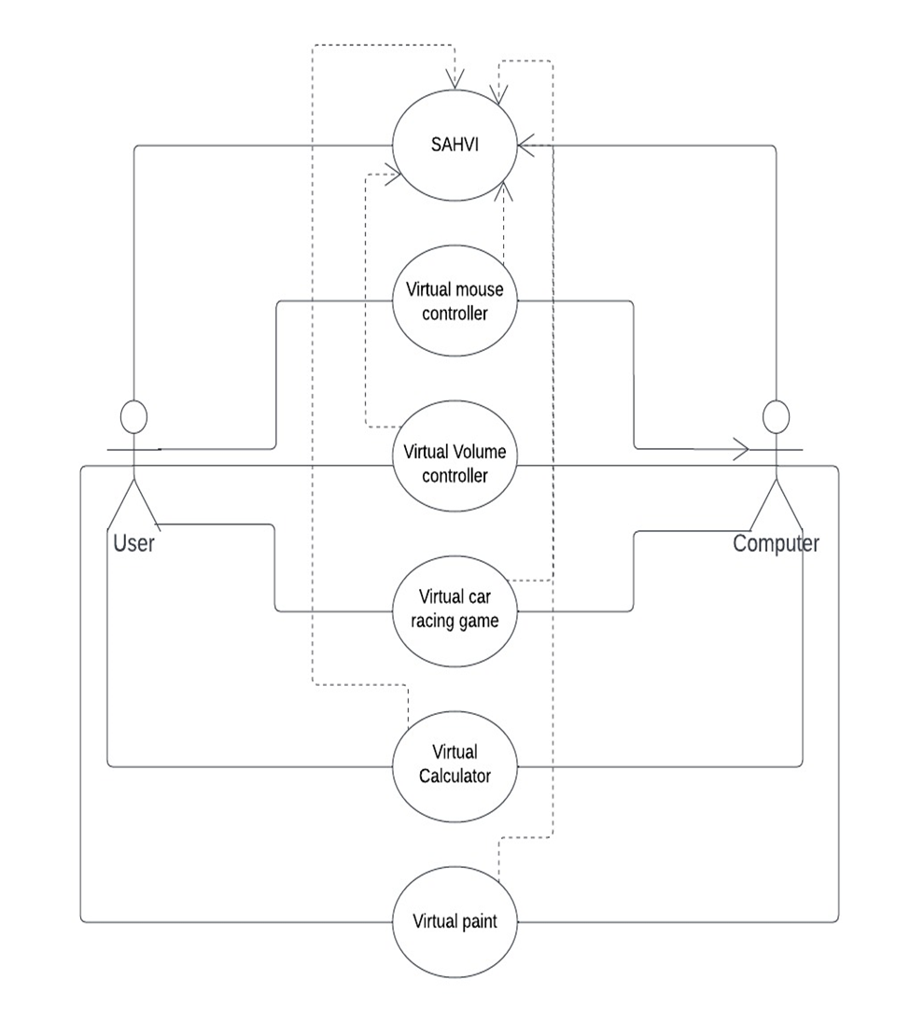
Use Case Diagram

Slide 9
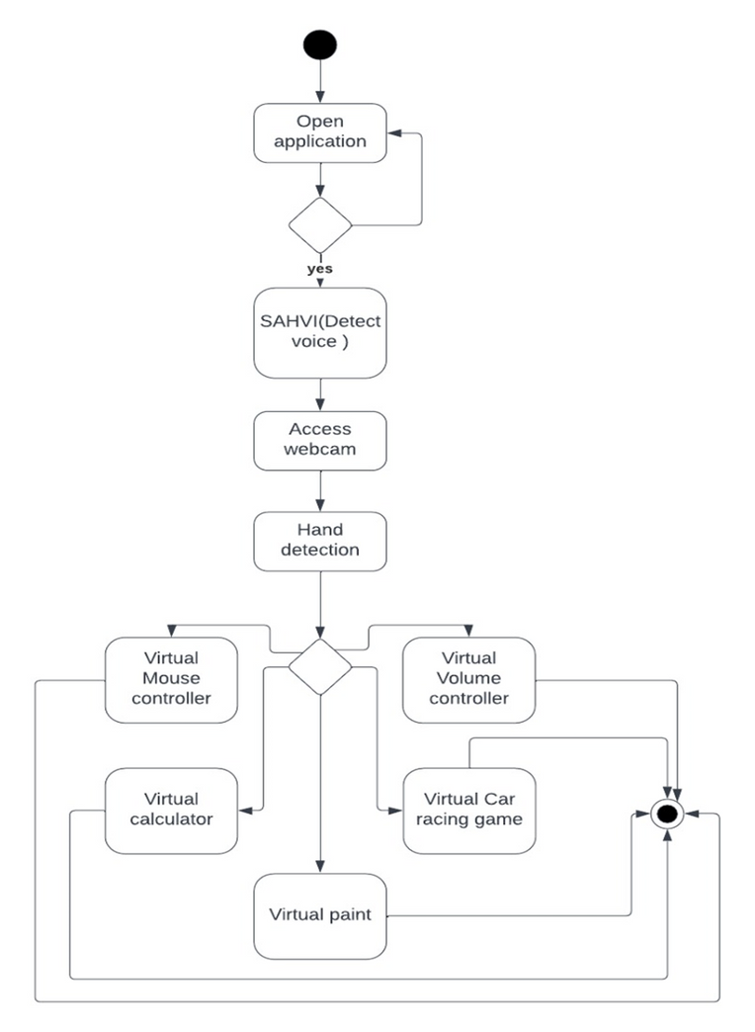
Activity Diagram

Slide 10
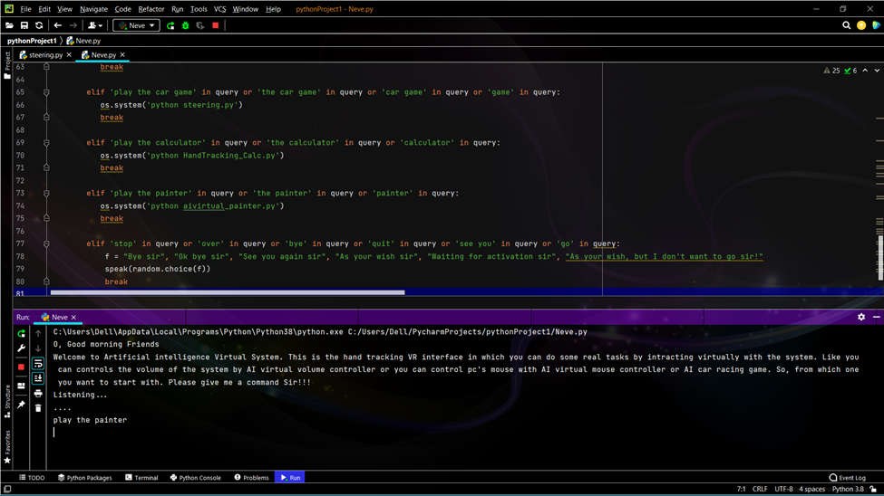
SAHVI Virtual Assistant

Slide 11
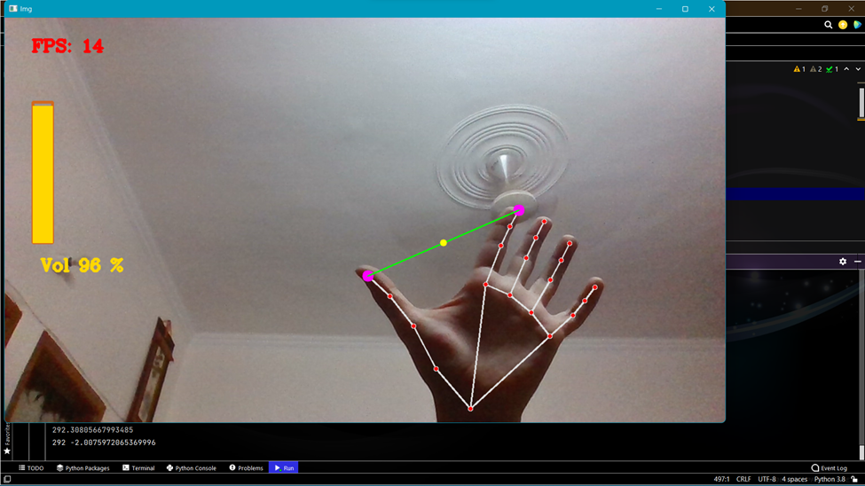
Virtual Volume Controller(VVC)

Slide 12
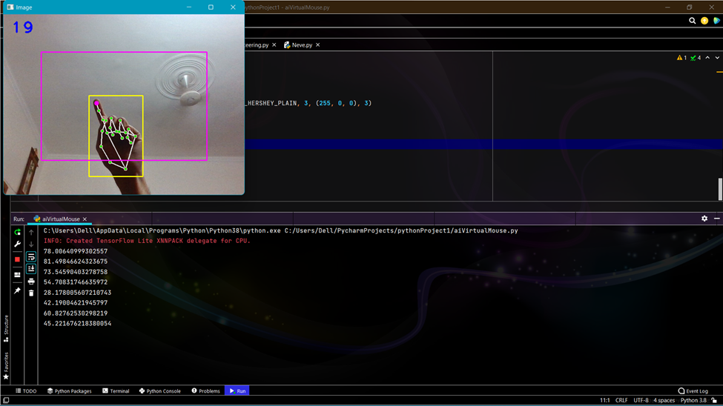
Virtual Mouse Controller(VMC)

Slide 13
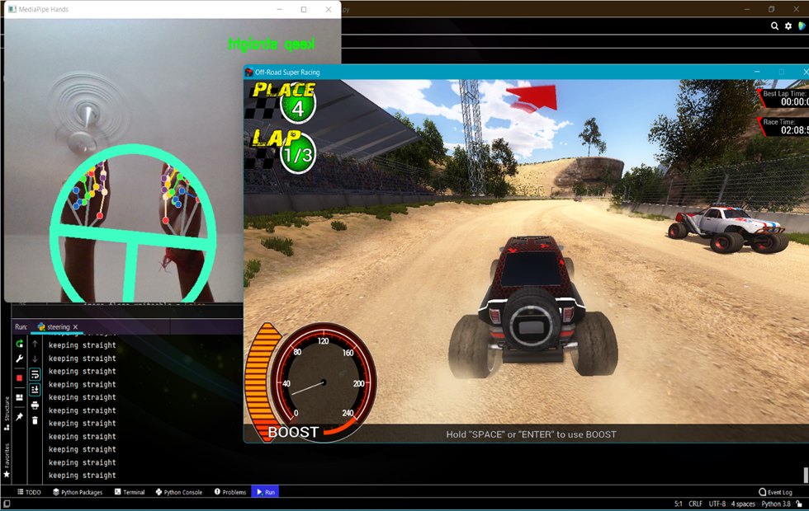
Virtual Game Controller(VGC)

Slide 14
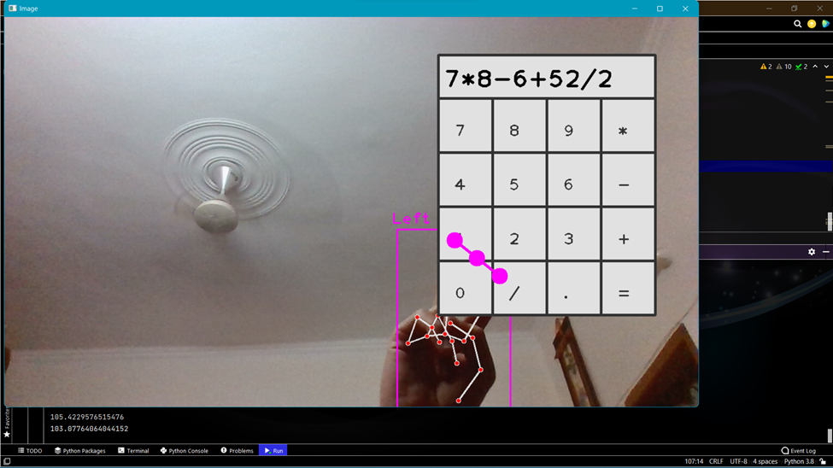
Virtual Calculator(VC)

Slide 15
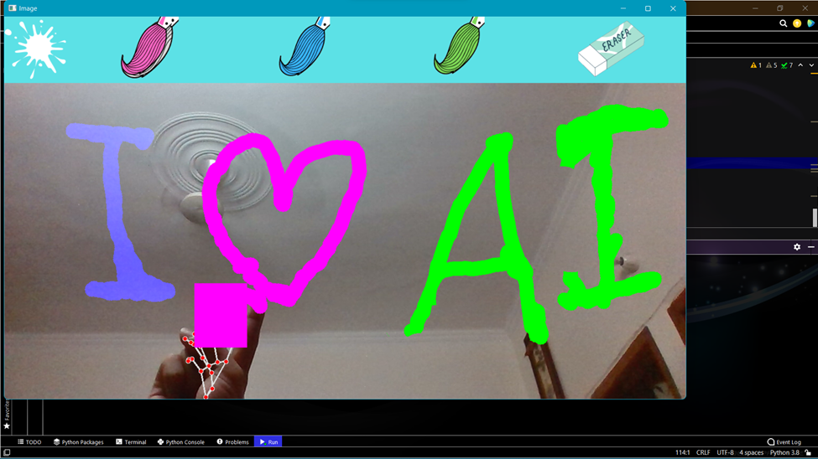
Virtual Painter(VP)

Slide 16
Outcomes
Towards touchless system with multiple functions integrated, we present a python-based virtual system. The specific group of audience targeted is young generation and working people of middle class and above class who are familiar with systems.

